Slide 1




University Institute of Engineering
Department of Computer Science & Engineering
COMPUTER ORGANIZATION & ARCHITECTURE
(23CST-204/23ITT-204)
ER. SHIKHA ATWAL
E11186
ASSISTANT PROFESSOR
BE-CSE

Slide 2
MEMORY MANAGEMENT HARDWARE
Memory management hardware plays a crucial role in computer architecture by efficiently allocating and managing the available memory resources. It is responsible for managing and organizing the memory subsystem, ensuring optimal performance, and facilitating the execution of various programs and processes. This article explores the various aspects of memory management hardware, including its components, functions, and techniques.

Slide 3
Components of Memory Management Hardware
The memory management hardware consists of several key components that work together to ensure efficient memory usage and allocation. These components include:
Memory Management Unit (MMU): The MMU is a critical component of memory management hardware. It translates virtual addresses to physical addresses, enabling the system to access the correct memory location.
Translation Lookaside Buffer (TLB): The TLB is a cache that stores recently used virtual-to-physical address translations, speeding up the address translation process.
Memory Segmentation Unit: This unit divides the memory into fixed-size segments to organize and manage memory resources efficiently.
Memory Protection Unit (MPU): The MPU ensures the security and protection of memory by enforcing access permissions and preventing unauthorized access.

Slide 4
Memory Management Unit (MMU)
The Memory Management Unit (MMU) is a key component of memory management hardware in computer architecture. It performs the essential task of translating virtual addresses generated by the CPU into physical addresses, allowing the system to access the correct memory location.
The MMU works in conjunction with the operating system's memory management software to allocate and manage memory resources effectively. It uses a technique called address translation, which involves converting virtual addresses to physical addresses by utilizing page tables or translation tables.
The MMU also plays a vital role in memory protection by implementing memory access control and prevention mechanisms. It enforces access permissions, ensuring that each process can only access its allocated memory and preventing unauthorized access to sensitive information.

Slide 5
Translation Lookaside Buffer (TLB)
The Translation Lookaside Buffer (TLB) is a cache in the memory management hardware that stores recently used virtual-to-physical address translations. It acts as a high-speed memory for address translation, improving the overall performance of the system.
When the CPU generates a virtual address, the TLB checks if the translation for that address is available in its cache. If the translation is found, the TLB provides the corresponding physical address, eliminating the need for a time-consuming lookup in the page tables or translation tables.
The TLB operates on the principle of locality, which states that recently accessed memory locations are likely to be accessed again in the near future. By storing frequently used translations, the TLB reduces the overhead of address translation, improving system performance.

Slide 6
Functions of Memory Management Hardware
The memory management hardware performs several critical functions to ensure efficient memory usage and allocation. These functions include:
Address Translation: The memory management hardware translates virtual addresses into physical addresses, allowing the CPU to access the correct memory location.
Memory Allocation: It allocates and deallocates memory resources to processes, ensuring that each process has sufficient memory to execute efficiently.
Memory Protection: The memory management hardware enforces access permissions and prevents unauthorized access to memory areas.
Virtual Memory Management: It manages the mapping of virtual addresses to physical addresses, enabling the efficient use of limited physical memory by utilizing disk-based virtual memory.

Slide 7
Address Translation
Address translation is one of the primary functions of memory management hardware. It involves converting virtual addresses generated by the CPU into physical addresses, allowing the system to access the correct memory location.
During address translation, the memory management hardware uses page tables or translation tables to map virtual addresses to physical addresses. This process ensures that each process has its isolated memory space, protecting it from interference by other processes.
Address translation is essential for enabling the efficient use of physical memory and facilitating the execution of multiple processes concurrently. By translating virtual addresses to physical addresses, the memory management hardware provides each process with a unique memory address space.

Slide 8
Memory Allocation
Memory allocation is another crucial function of memory management hardware. It involves assigning memory resources to processes and deallocating them when no longer needed.
The memory management hardware tracks the available memory blocks, allocating them to processes based on their memory requirements. It ensures that each process has a sufficient amount of memory to execute efficiently, preventing resource contention.
Efficient memory allocation allows for the simultaneous execution of multiple processes, maximizing system productivity. By managing memory resources effectively, the memory management hardware minimizes wastage and fragmentation, optimizing overall system performance.

Slide 9
Techniques Used in Memory Management Hardware
The memory management hardware employs various techniques to enhance memory utilization and performance. Some of the commonly used techniques include:
Paging: Paging involves dividing memory into fixed-size blocks called pages and mapping them in a virtual address space. It allows for efficient memory allocation and utilization by allocating pages based on demand.
Segmentation: Segmentation involves dividing memory into logical segments based on program structure and memory requirements. It provides a flexible memory allocation scheme but can lead to external fragmentation.

Slide 10
Techniques Used in Memory Management Hardware
Virtual Memory: Virtual memory is a technique that allows the execution of programs larger than the available physical memory. It uses disk-based storage to supplement the physical memory, transferring data between memory and disk as needed.
Memory Protection: The memory management hardware implements various memory protection mechanisms, such as access permissions and privilege levels, to ensure the security and integrity of memory.

Slide 11
Virtual Memory
Virtual memory is a memory management technique that allows the execution of programs larger than the available physical memory. It provides an illusion of larger memory space by utilizing disk-based storage as an extension of the physical memory.
In virtual memory, the memory management hardware transparently transfers data between the physical memory and disk storage as needed. It uses techniques like demand paging or demand segmentation to efficiently manage memory resources.
Virtual memory significantly improves system performance by allowing the execution of larger programs without requiring an equivalent amount of physical memory. By utilizing disk storage as a supplement to physical memory, virtual memory enables the efficient execution of memory-intensive applications.

Slide 12
Role of Memory Management Hardware in Computer Architecture
The memory management hardware plays a critical role in computer architecture by ensuring efficient memory usage, allocation, and protection. It facilitates the execution of various programs and processes by managing the memory subsystem effectively.
Memory management hardware components such as the MMU and TLB enable address translation, allowing the CPU to access the correct memory location. They also optimize memory access by caching frequently used translations, reducing the overhead of address translation.
By allocating memory resources to processes, the memory management hardware enables the simultaneous execution of multiple programs, maximizing system productivity. It also enforces memory protection mechanisms to ensure the security and integrity of memory, preventing unauthorized access and interference.

Slide 13
Furthermore, memory management hardware techniques like paging, segmentation, and virtual memory enhance memory utilization and performance. They allow for efficient memory allocation, utilization, and the execution of programs larger than the available physical memory.
In conclusion, memory management hardware is a crucial component of computer architecture. It plays a vital role in managing memory resources, optimizing performance, and ensuring the smooth execution of programs and processes.

Slide 14
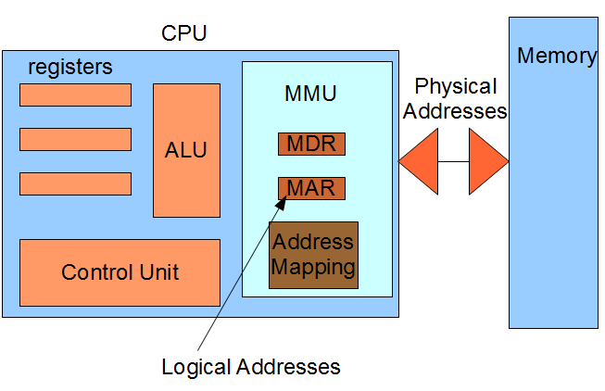

Slide 15
References
Reference Books:
J.P. Hayes, “Computer Architecture and Organization”, Third Edition.
Mano, M., “Computer System Architecture”, Third Edition, Prentice Hall.
Stallings, W., “Computer Organization and Architecture”, Eighth Edition, Pearson Education.
Text Books:
Carpinelli J.D,” Computer systems organization &Architecture”, Fourth Edition, Addison Wesley.
Patterson and Hennessy, “Computer Architecture”, Fifth Edition Morgaon Kauffman.

Slide 16
Other References
https://www.ques10.com/p/10067/what-is-virtual-memory-explain-the-role-of-pagin- 1/
https://www.enterprisestorageforum.com/storage-hardware/paging-and- segmentation.html
https://www.cmpe.boun.edu.tr/~uskudarli/courses/cmpe235/Virtual%20Memory.pdf

